Slide 1
Modules & Packages, ​ File Handling
& ​ Exception Handling

Slide 2
Modules & Packages
A module in Python is essentially a .py file that contains Python code, which may include functions, classes, or variables.
Modules are used to break down large programs into smaller, manageable, and organized sections. They act as self-contained units of code that can be imported and used in other programs or modules.
A package in Python is a collection of Python modules organized in a directory. It is essentially a directory with a file named __init__.py, which may be empty but signifies to Python that this directory is a package.
Packages allow for a hierarchical structuring of the module namespace, providing a way of organizing related modules in a single namespace.

Slide 3
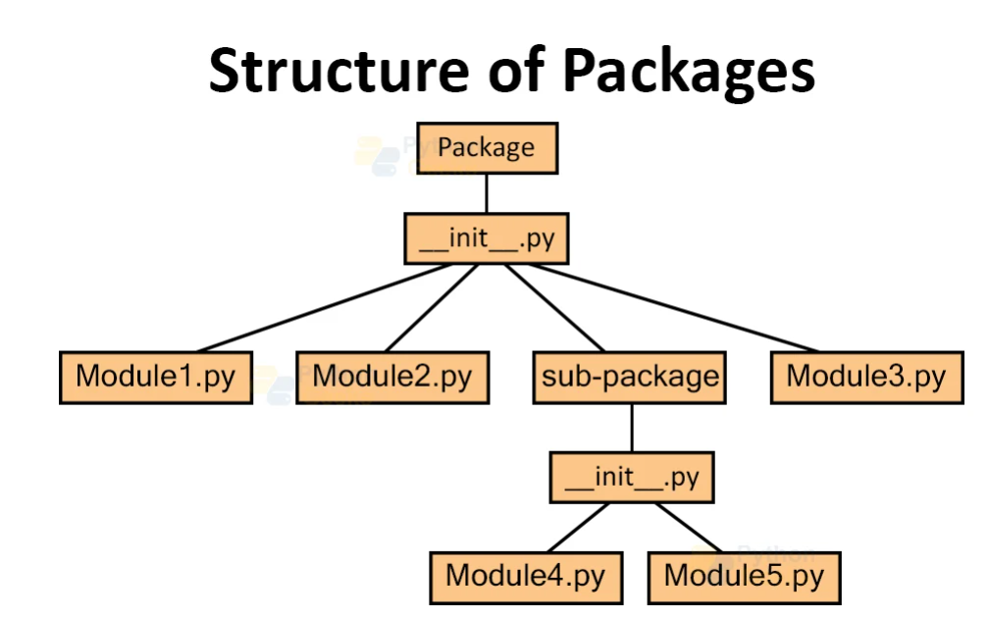
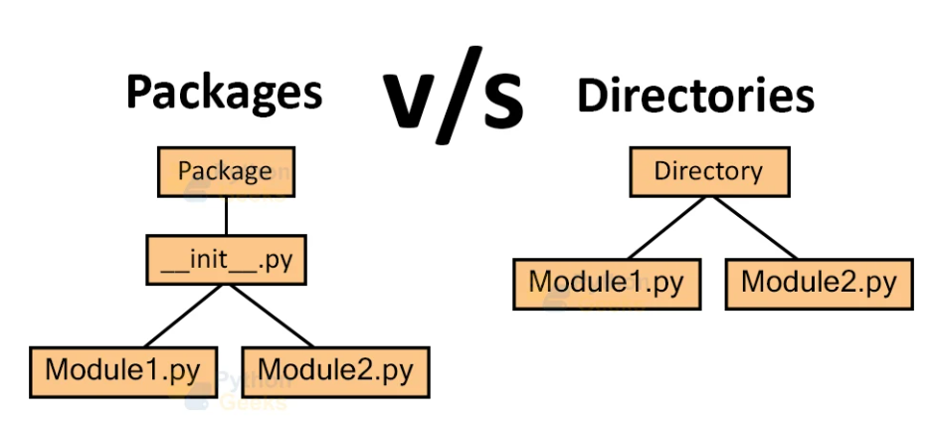
PACKAGE STRUCTURE

Slide 4
BENEFITS OF USING MODULES AND PACKAGES
Maintainability: Breaking down code into modules helps make changes in the independent parts of the overall application without affecting the whole application.
Reusability: Writing code once and using it in many different parts of an application as many times as needed, leading to cleaner and DRY (Don't Repeat Yourself) code.
Collaboration: Modular code enhances and enables collaboration, allowing different teams to work on different parts of the same application simultaneously without interfering with each other’s work.
Readability: Enhancing code readability by clearly indicating what each file or module deals with, such as a file named databaseConnection.py dealing with database connections.

Slide 5
FILE HANDLING
File handling in Python refers to the process of interacting with files on the filesystem.
This includes operations such as reading from files, writing to files, appending data, and managing file pointers.
Modes for Opening Files -
"r": Read-only mode, "a": Append mode,
"w": Write mode, "x": Exclusive creation mode.

Slide 6
r -> read mode
only opens for reading
pointer at start
if no such file exists will give error
w -> write mode
only opens for write mode
all existing data gets deleted
new file is created if file not present
a -> append mode
will open for appending data only
will add new data after existing data
new file will be created if file doesn't existing
x -> Exclusive mode
Open a file for exclusive creation. If the file already exists, the operation fails.
with statement automatically closes the file.
r+ -> read write mode
can read as well as write data
existing data will not be deleted
cannot create new file if file does not exists
pointer is at begining of File
w+ -> write read mode
can read as well as write data
existing data will be deleted or overridden
creates file if does not exists
a+ -> append read mode
can read as well as write data
existing data will not be deleted or overridden
creates file if does not exists
pointer is at end of File

Slide 7
ERRORS & EXCEPTION HANDLING
State in which normal operation or normal flow is not possible.
THREE MAIN TYPES OF ERRORS -
Syntax Errors: Prevent the program from being executed due to structural issues in the code. They are detected at parse-time.
Runtime Errors (Exceptions): Occur during the execution of the program and can be caught and handled using try-except blocks. They are detected at runtime.
Logical Errors: Lead to incorrect program behavior without causing the program to crash. They require careful review and testing to identify and fix.

Slide 8
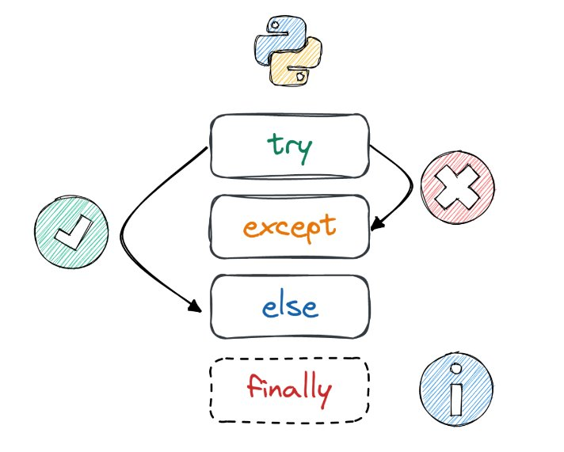
TRY, EXCEPT, ELSE, FINALLY
try block - code which has probability to generate error is written here
except block - possible solution to handle error from try block is written here
else block - if no exception is raised else gets executed
finally block - gets executed irrespective of whether exception arises or not

